Slide 1
Using Python to Retrieve Weather Observations from a Mesonet API with Application to Practical Use Cases
AMS Annual Meeting 2023
Short Course

Slide 2
Schedule
Introductions
Motivation & Background
– break –
Hands-on 1: The data Synoptic aggregates
Hands-on 2: Colab Notebook - primer
– break –
Hands-on 3: Colab Notebook - road wx
Hands-on 4: Colab Notebook - fire wx
– break –
Hands-on 5: Attendee use cases/problems
(Optional) Hands-on: Precipitation
© 2022 - Synoptic Data - A Public Benefit Corporation
Notes:
U.S. Navy photo by Machinery Repairman 2nd Class Jerry Neblett. - This image was released by the United States Navy with the ID 040306-N-0000X-004
https://www.ncei.noaa.gov/maps/radar/

Slide 3



Who is Synoptic?
Late 1990s: Begin growing mesonet & user community
National Mesonet Program
Operational
NMP responsibilities
Build, maintain API
Public Benefit Corporation

Slide 4
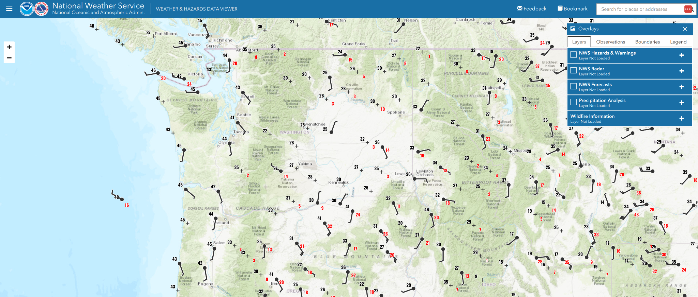
Obs available to public from Synoptic are same obs used for situational awareness by WFOs

Slide 5
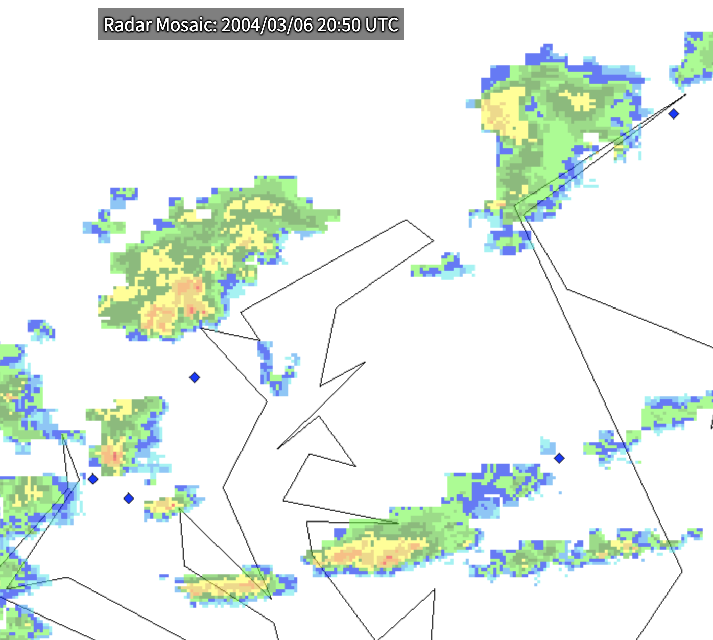
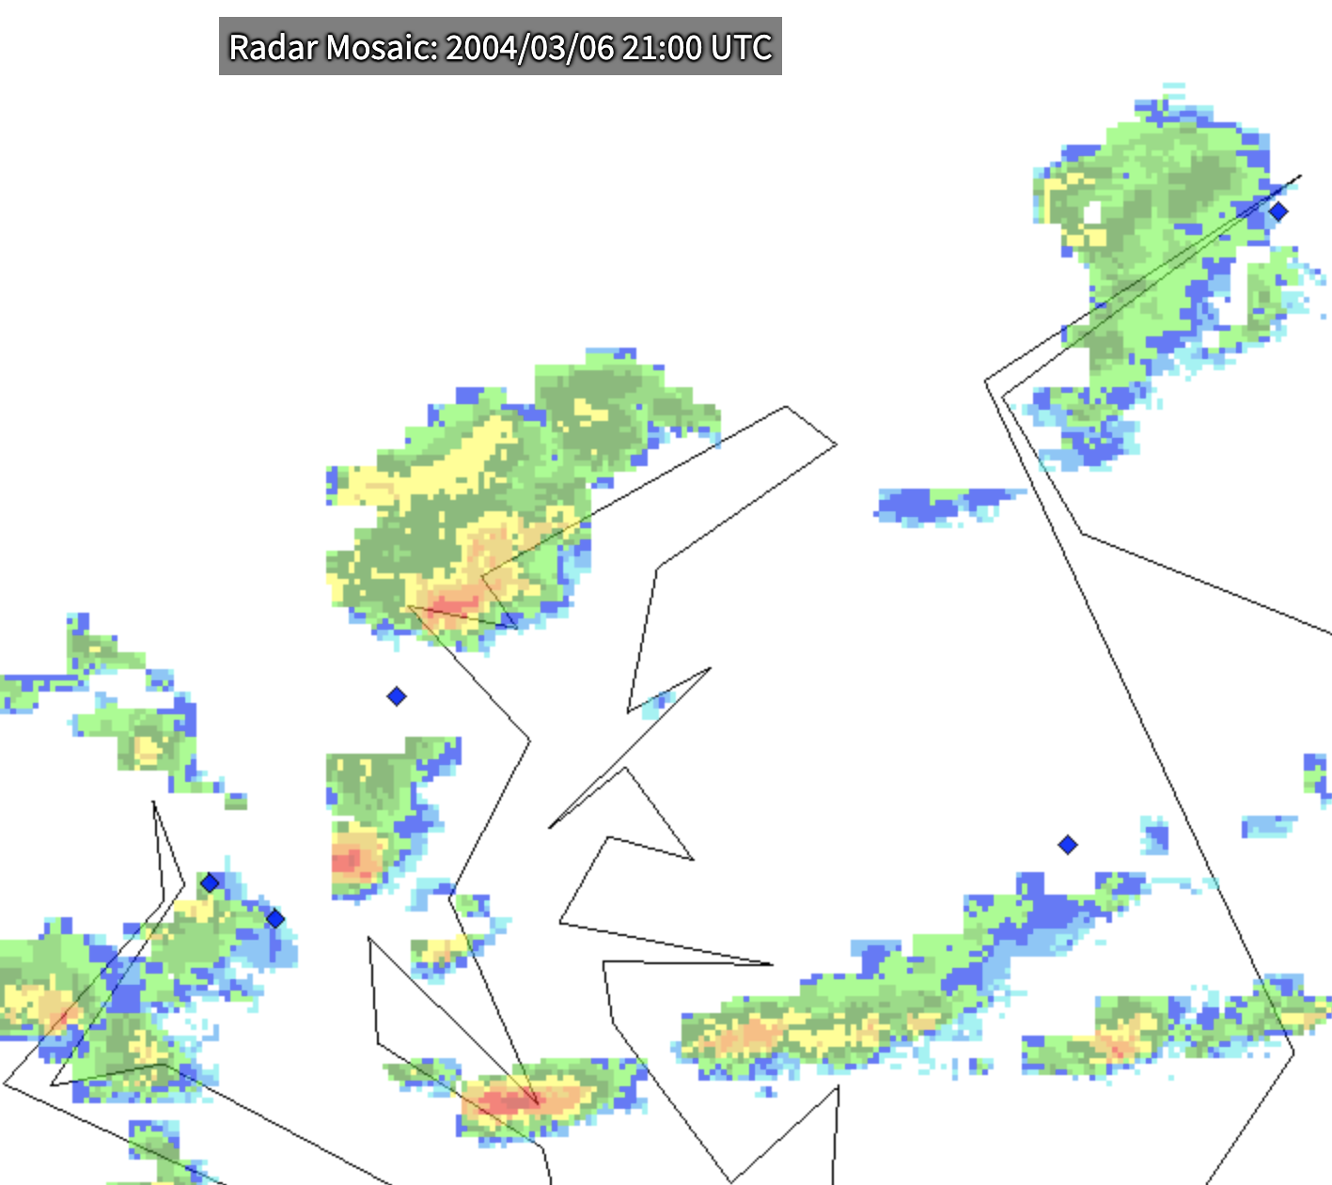
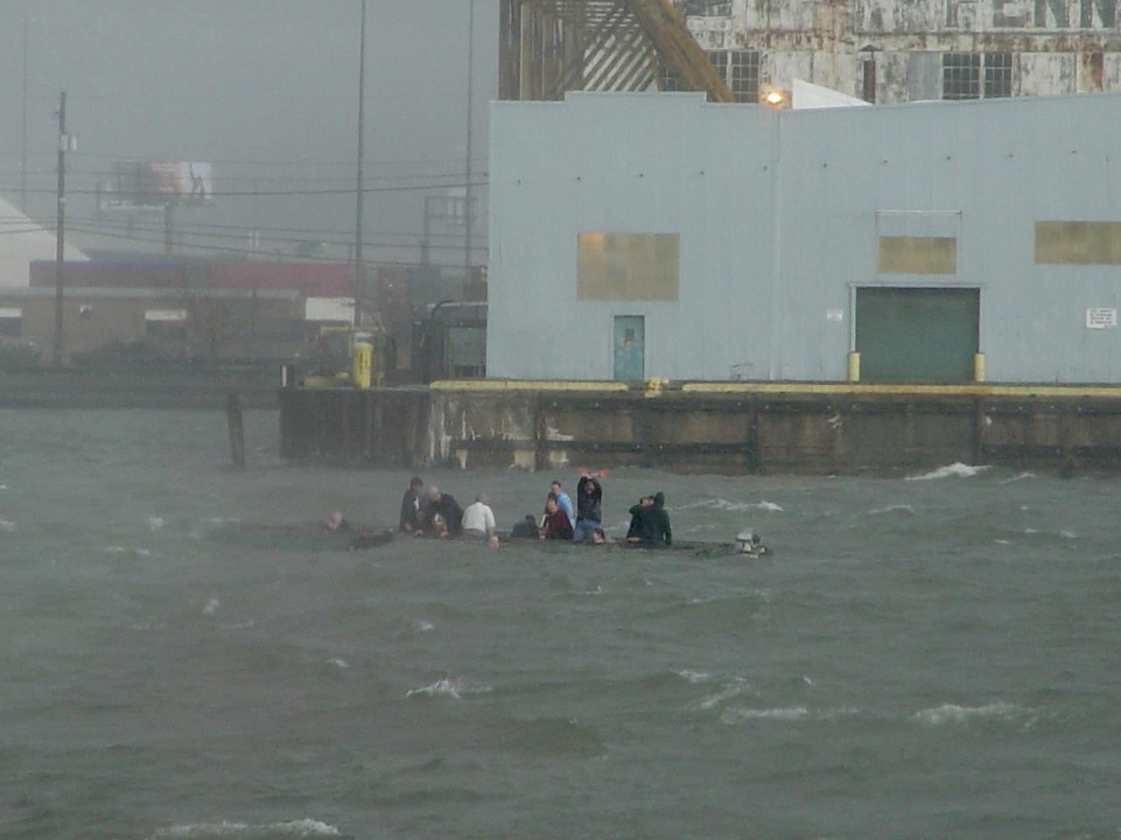
Motivation - Why More Observations Matter
© 2022 - Synoptic Data - A Public Benefit Corporation
Notes:
U.S. Navy photo by Machinery Repairman 2nd Class Jerry Neblett. - This image was released by the United States Navy with the ID 040306-N-0000X-004
https://www.ncei.noaa.gov/maps/radar/

Slide 6

Why More Observations Matter
© 2022 - Synoptic Data - A Public Benefit Corporation
Notes:
NBC Nightly News clip on Baltimore Water Taxi Accident

Slide 7
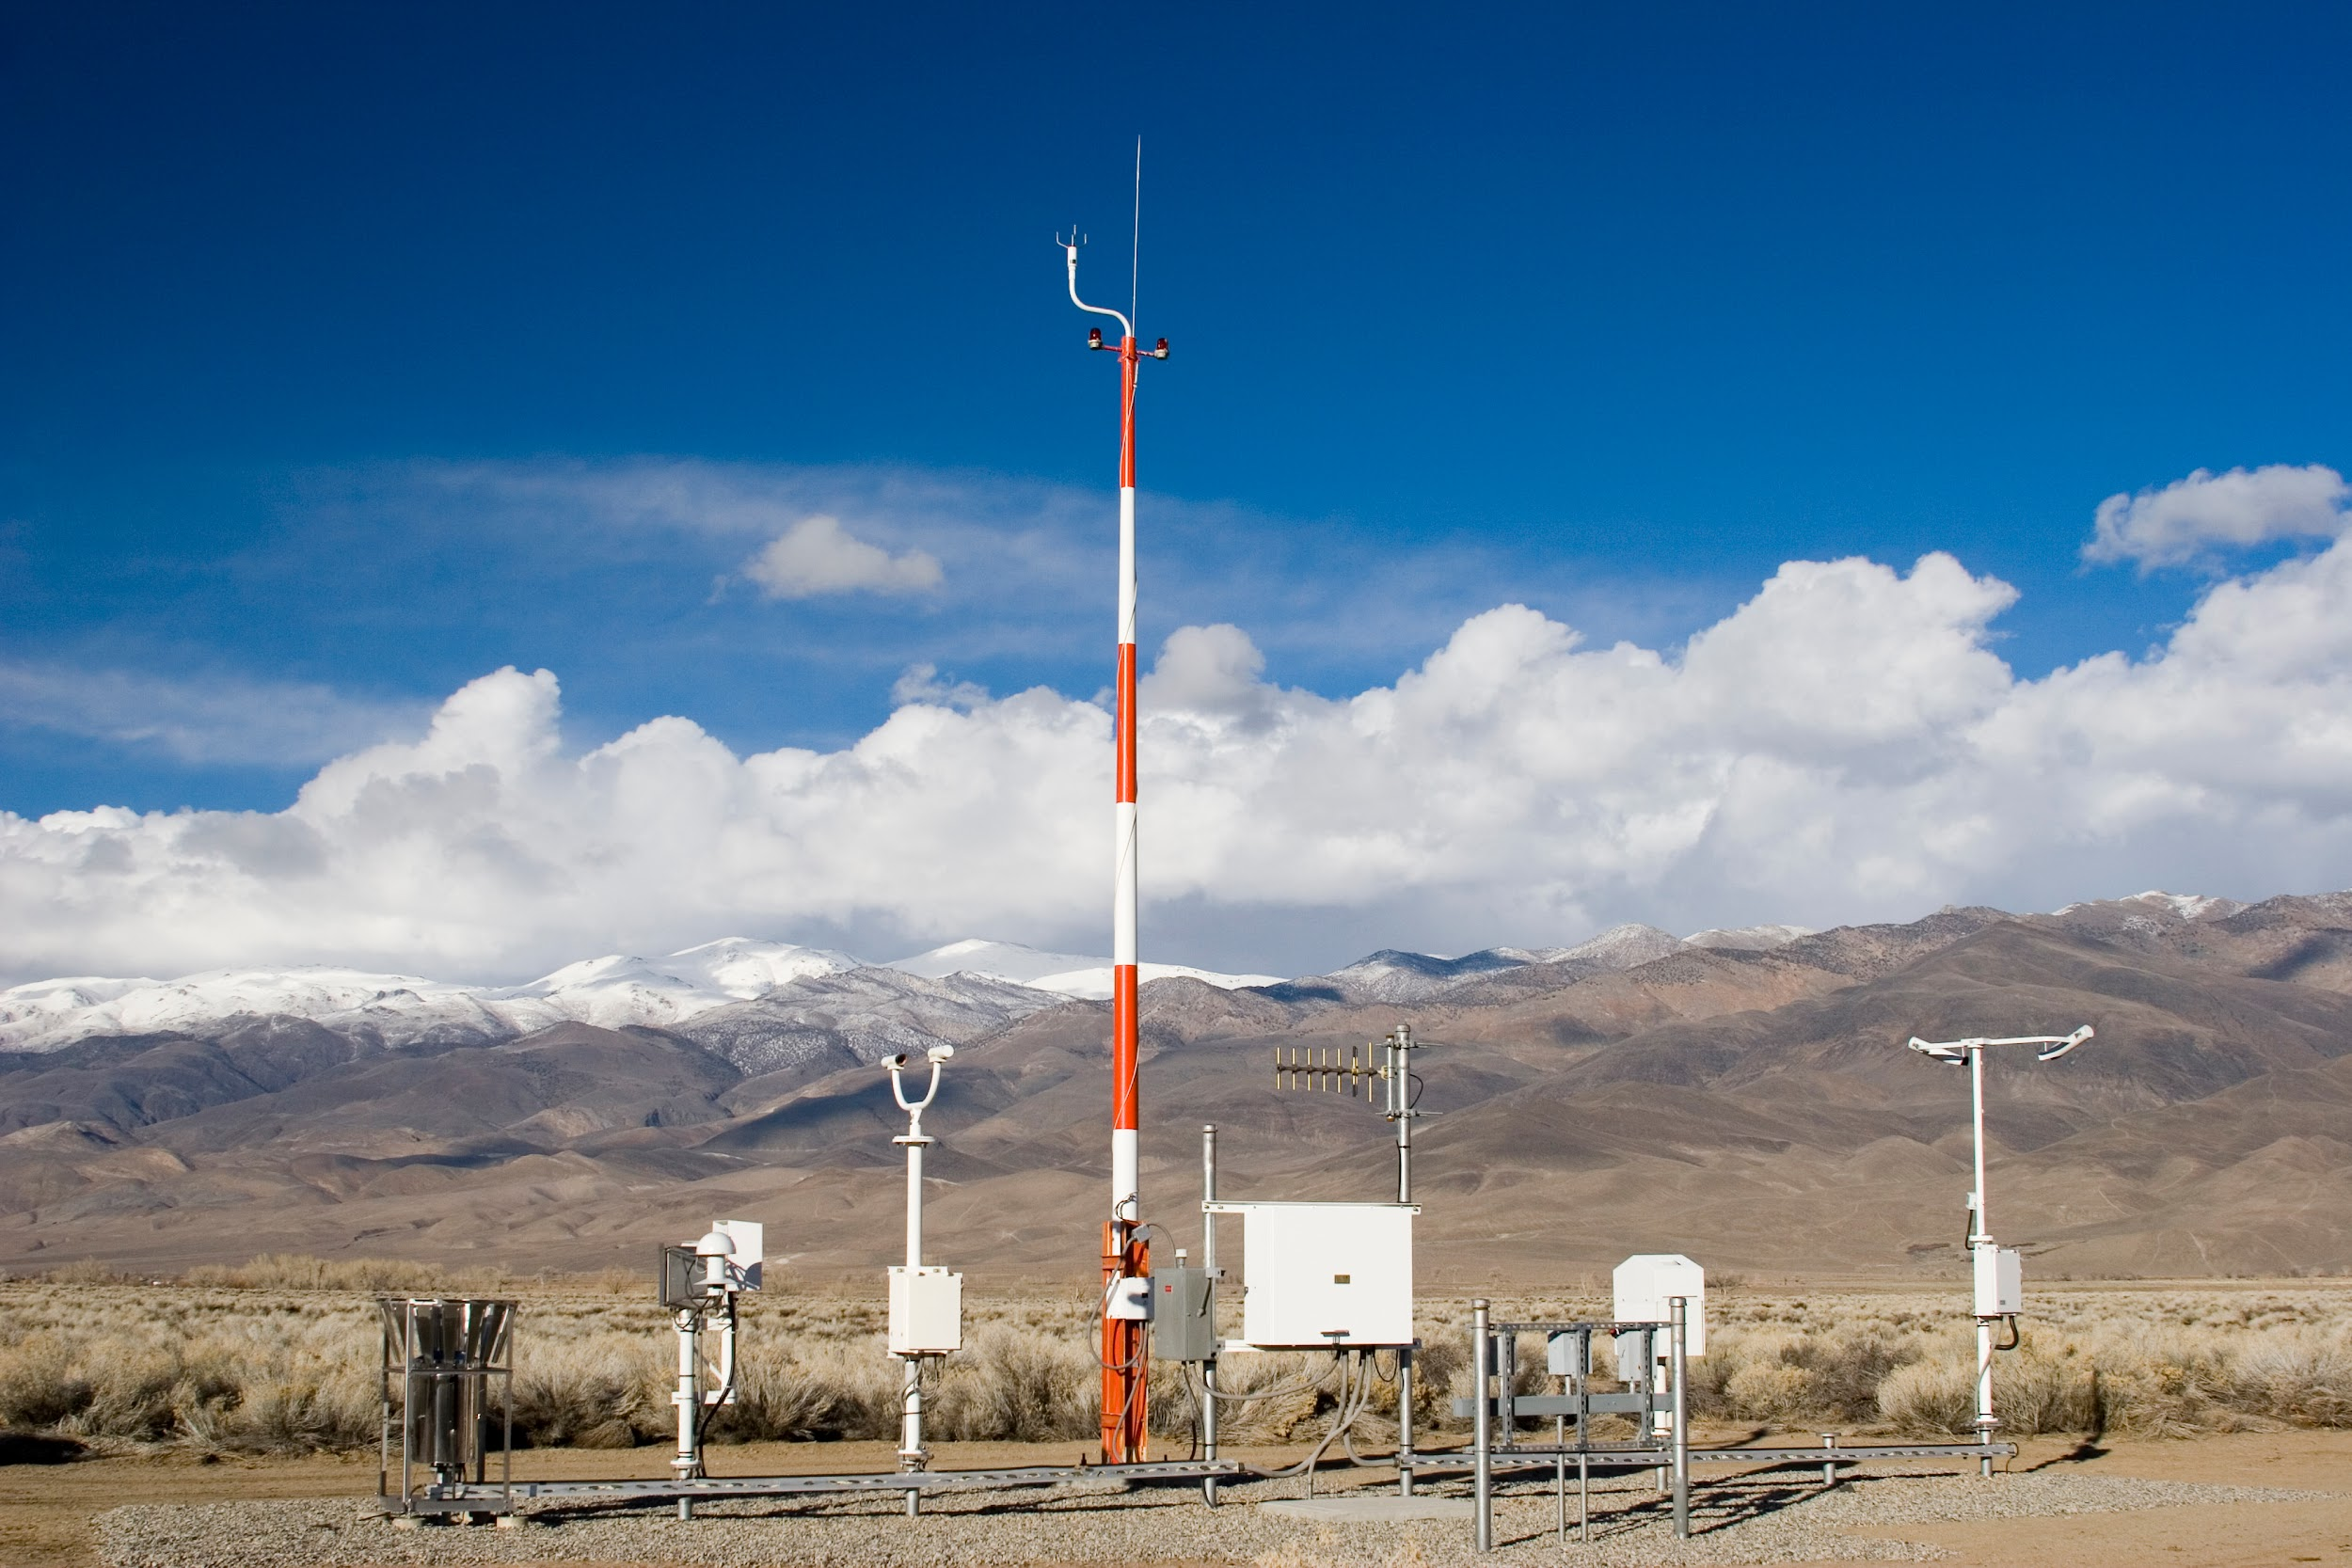
Measurement to Dissemination - The station
The station site needs three things:
Instrumentation
Power source
Communication channel (hardwire, cell modem, satellite, etc)
© 2022 - Synoptic Data - A Public Benefit Corporation

Slide 8
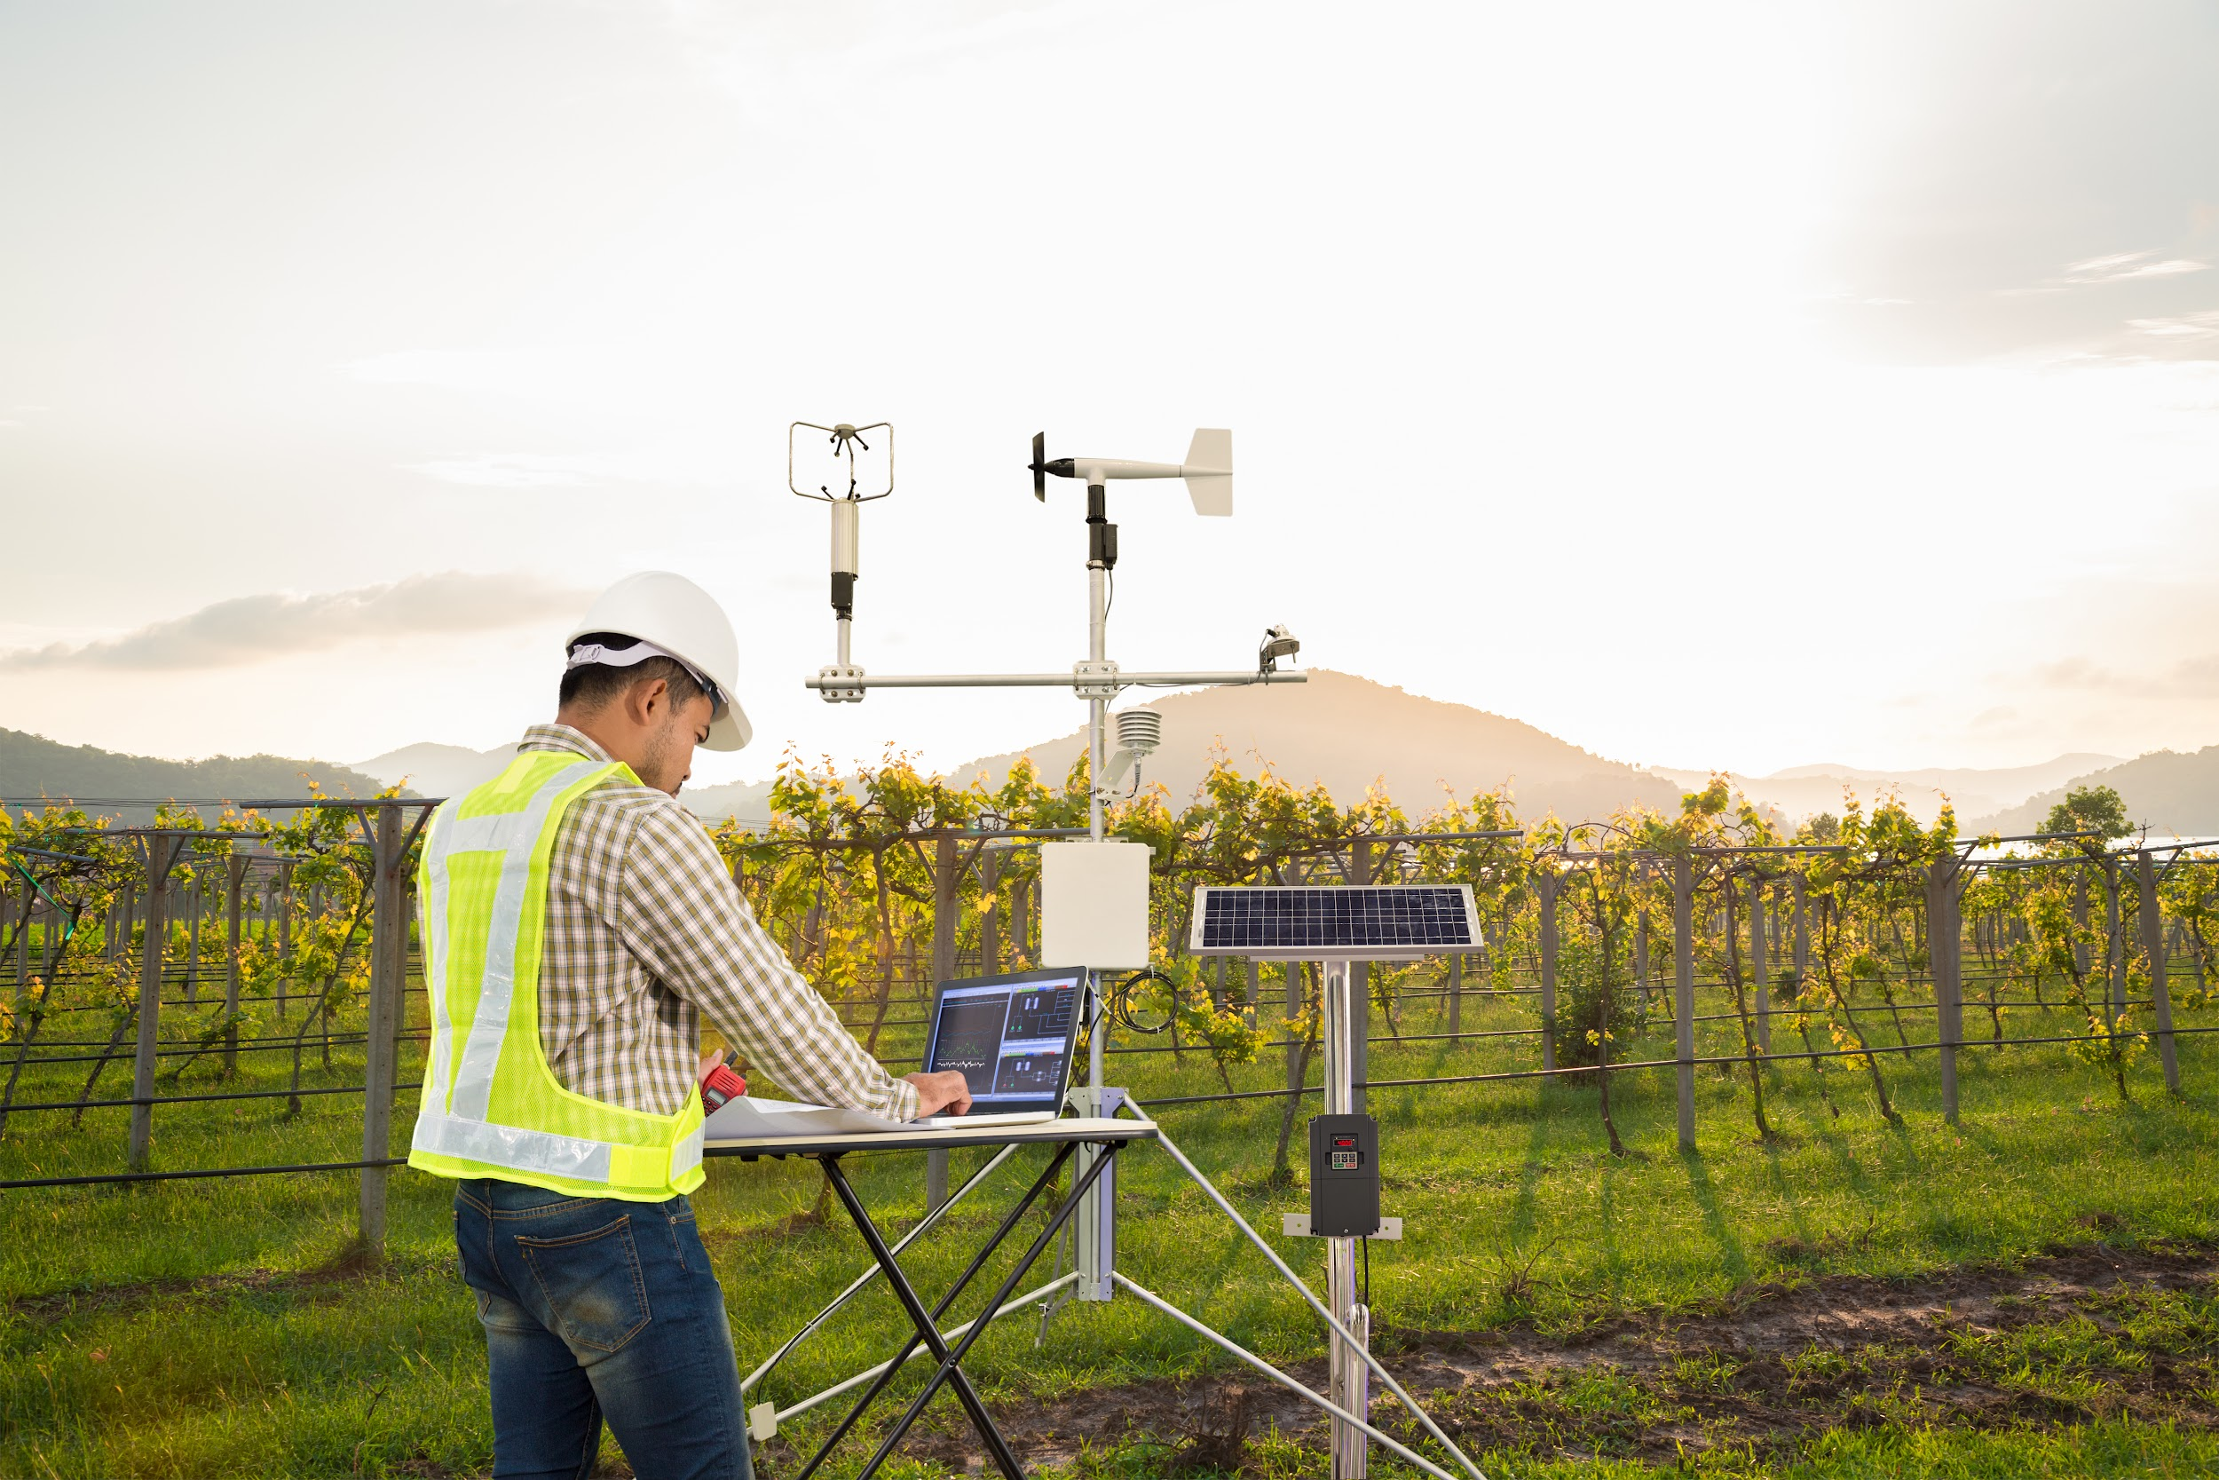
Measurement to Dissemination - The instruments
Instantaneous wind speed, direction (anemometer)
Instantaneous wind speed, direction (sonic)
Relative humidity
Temperature, pressure
Each produces an electric signal that is collected, and processed by a data logger.
The logger will average, remember what maximum values are within a set interval.
All or some rolling window of data is stored on the data logger.
Data is retrieved or more commonly transmitted to some source (home computer, central network server)
© 2022 - Synoptic Data - A Public Benefit Corporation

Slide 9
Measurement to Dissemination - The data
Datetime | Temperature | Relative Humidity | Pressure | Wind Speed | Wind Direction
1/8/2023 8:00AM LST | 50 | 40 | 905.7 | 2.0 | 167
1/8/2023 8:15AM LST | 50 | 40 | 905.7 | 3.0 | 163
1/8/2023 8:30AM LST | 51 | 38 | 905.6 | 3.0 | 168
1/8/2023 8:45AM LST | 52 | 37 | 905.6 | 2.0 | 170
Say your personal weather station is sending this data to your personal computer. If we wanted to share this data so others could use it, says NWS forecasters, researchers, what kinds of questions might they have?
© 2022 - Synoptic Data - A Public Benefit Corporation

Slide 10
Measurement to Dissemination - Metadata
Datetime (Mountain Time Zone) | Temperature (°F) | Relative Humidity (%) | Pressure (mb) | Wind Speed (mph) | Wind Direction (°)
1/8/2023 8:00AM LST | 50 | 40 | 905.7 | 2.0 | 167
1/8/2023 8:15AM LST | 50 | 40 | 905.7 | 3.0 | 163
1/8/2023 8:30AM LST | 51 | 38 | 905.6 | 3.0 | 168
1/8/2023 8:45AM LST | 52 | 37 | 905.6 | 2.0 | 170
Other details that we need to provide
Location - latitude, longitude, elevation ASL, time zone
Units - of all measured variables
Other more detailed - instrumentation type, maintenance records,
© 2022 - Synoptic Data - A Public Benefit Corporation

Slide 11

Measurement to Dissemination - Transmitting
Datetime (Mountain Time Zone) | Temperature (°F) | Relative Humidity (%) | Pressure (mb) | Wind Speed (mph) | Wind Direction (°)
1/8/2023 8:00AM LST | 50 | 40 | 905.7 | 2.0 | 167
1/8/2023 8:15AM LST | 50 | 40 | 905.7 | 3.0 | 163
1/8/2023 8:30AM LST | 51 | 38 | 905.6 | 3.0 | 168
1/8/2023 8:45AM LST | 52 | 37 | 905.6 | 2.0 | 170
Weather observations need to be transmitted to some central server or community server, examples include
Government network central server
A local NWS office server
CWOP server
© 2022 - Synoptic Data - A Public Benefit Corporation

Slide 12
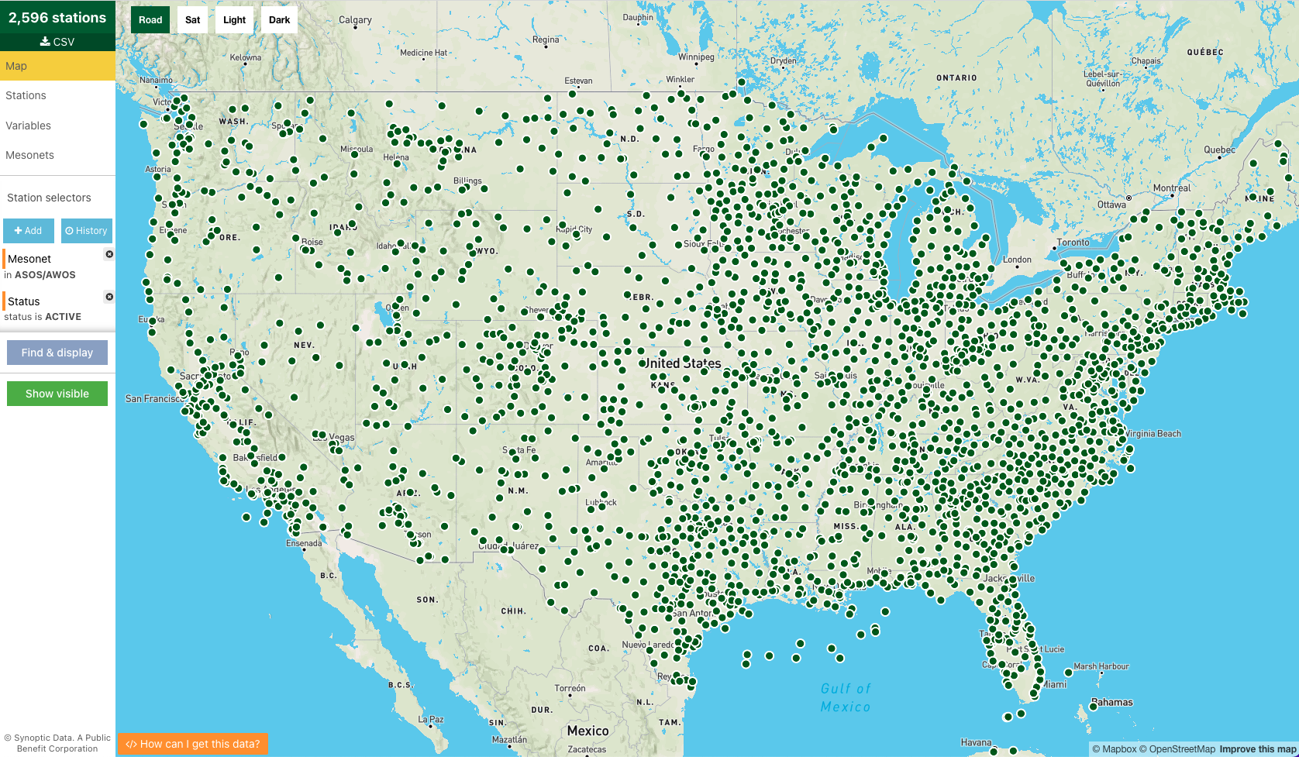
Data Providers - Who are they?
Federal, state, and local governments
Monitoring conditions for transportation safety, emergency response, etc.
Data used internally and often shared publicly
Stations located at airports (ASOS/AWOS), along highways (DOTs), or across cities (e.g. Hennepin county)
© 2022 - Synoptic Data - A Public Benefit Corporation

Slide 13
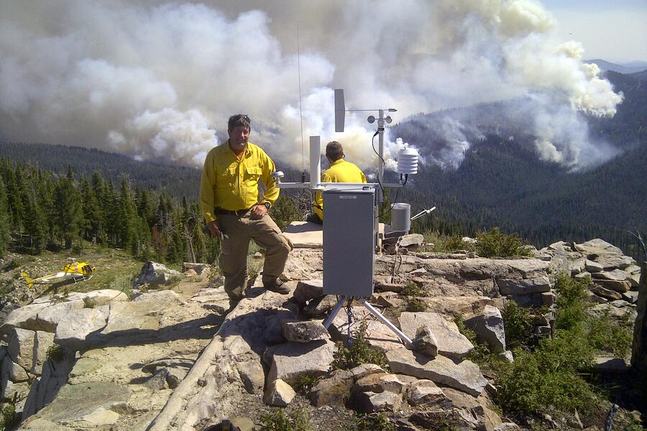
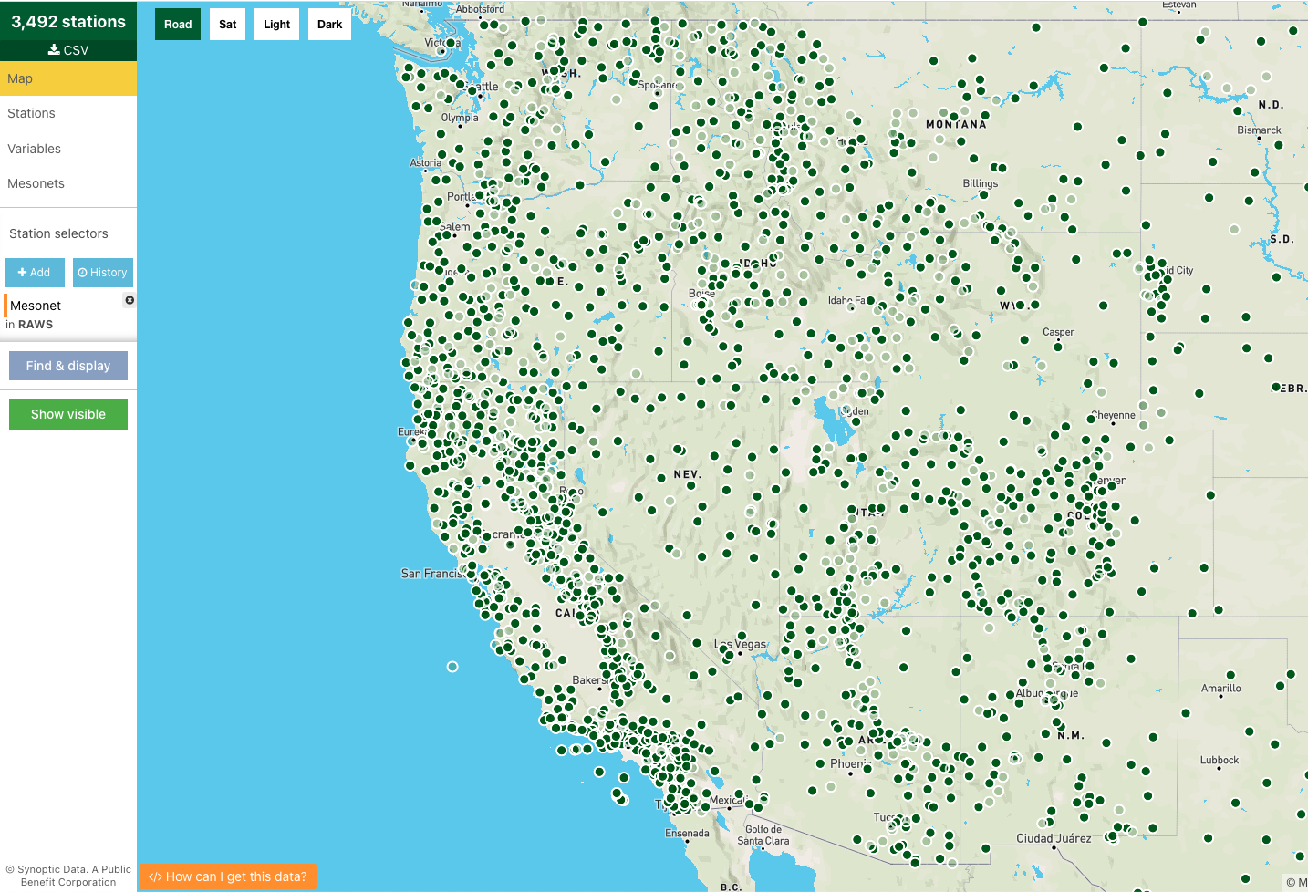
Data Providers - Who are they?
Fire Weather (RAWS, IRAWS)
Monitoring weather conditions related to fire danger, air quality, research
Data used internally and often shared publicly
Stations located most densely across the western US in rugged terrain and fire prone areas
© 2022 - Synoptic Data - A Public Benefit Corporation
Notes:
Information from https://www.nifc.gov/about-us/what-is-nifc/remote-automatic-weather-stations#:~:text=These%20stations%20monitor%20the%20weather,providing%20information%20for%20research%20applications.

Slide 14
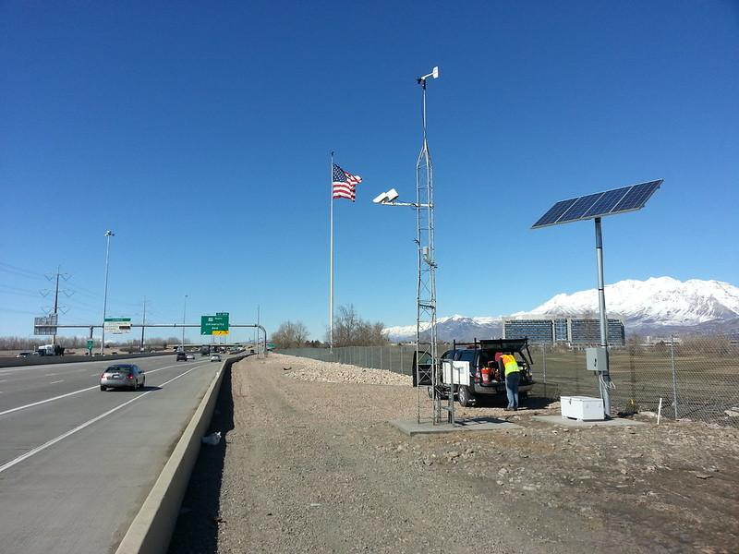
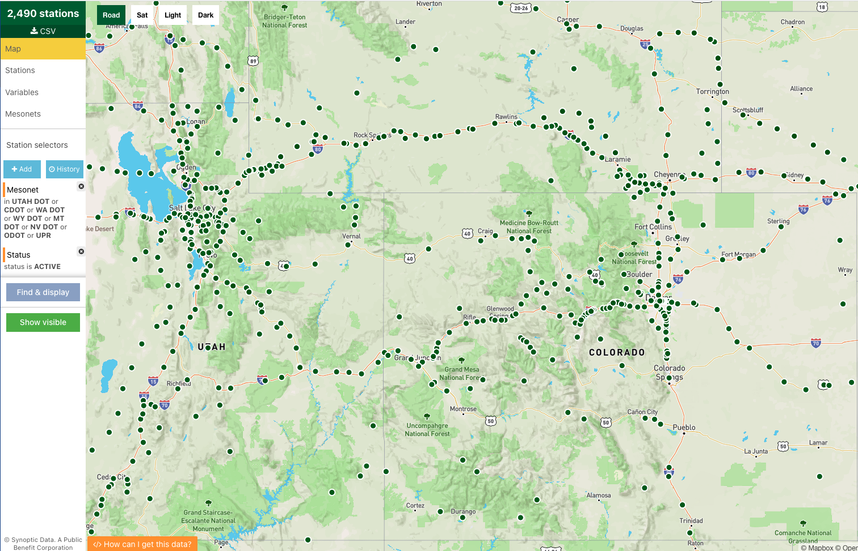
Data Providers - Who are they?
Road and Railway Weather Networks
Monitoring weather conditions near and along railways and roadways
Data used internally and often shared publicly (not always easily accesible)
Stations located along highways and railways
© 2022 - Synoptic Data - A Public Benefit Corporation

Slide 15
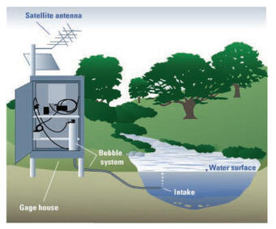
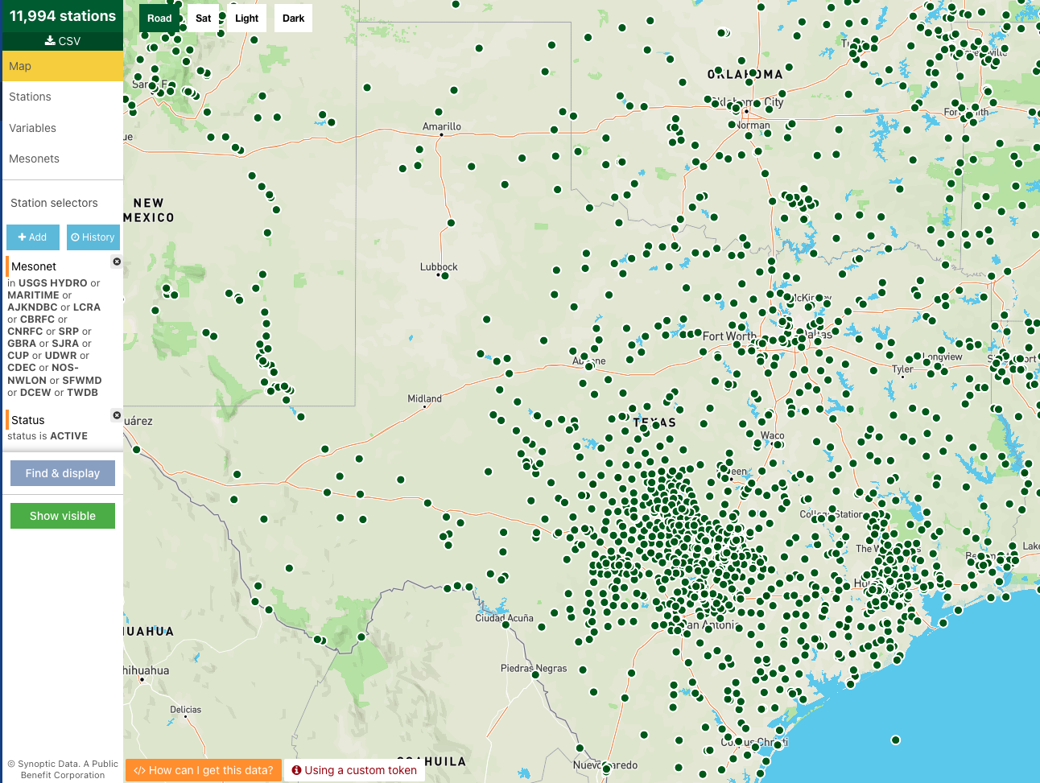
Data Providers - Who are they?
Hydrological Networks
Measuring various water-related variables such as streamflow, water level, water height
Data used internally and often shared publicly
Stations located along streams, rivers, lakes, reservoirs and coastal locations for monitoring water levels, flow, and coastal tsunami hazards
© 2022 - Synoptic Data - A Public Benefit Corporation
Notes:
Information from
https://www.usgs.gov/mission-areas/water-resources/science/streamgaging-basics

Slide 16
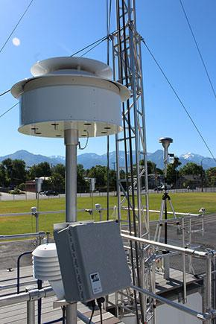
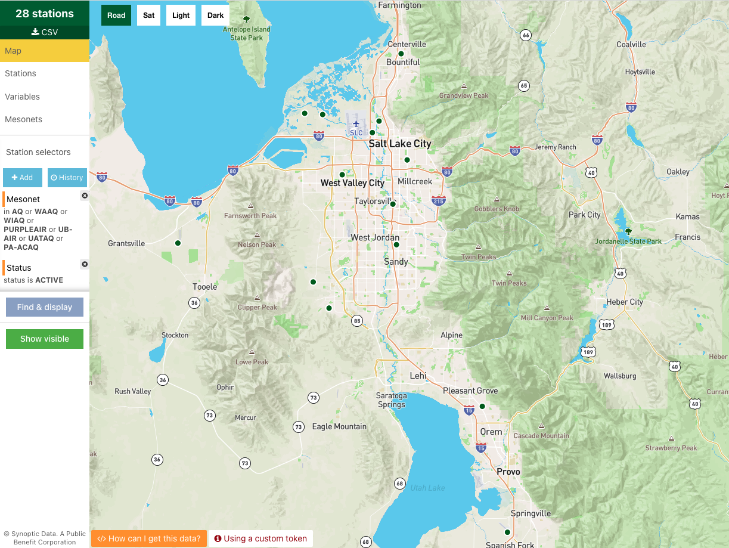
Data Providers - Who are they?
Air Quality Networks
Measuring weather and particulate matter for air quality monitoring
Data used internally and often shared publicly
Stations typically located across certain urban corridors (more personal, home stations coming online)
© 2022 - Synoptic Data - A Public Benefit Corporation

Slide 17
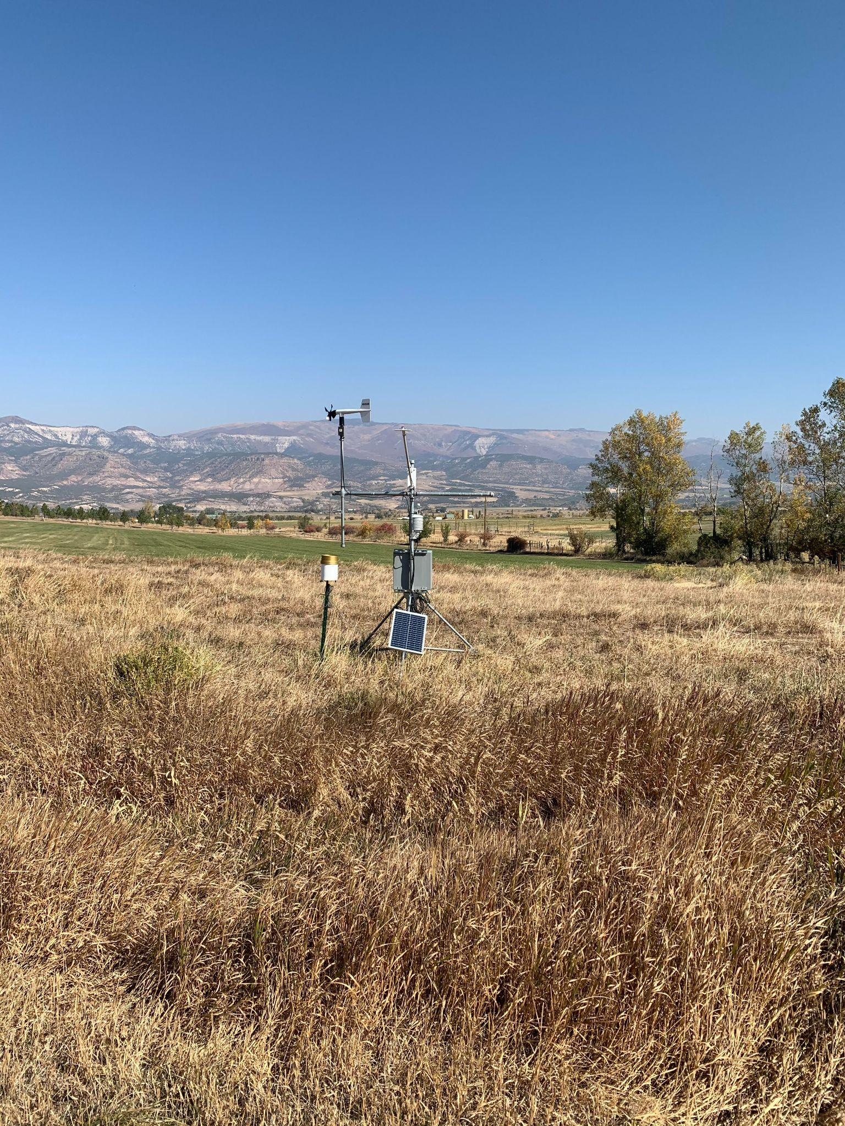
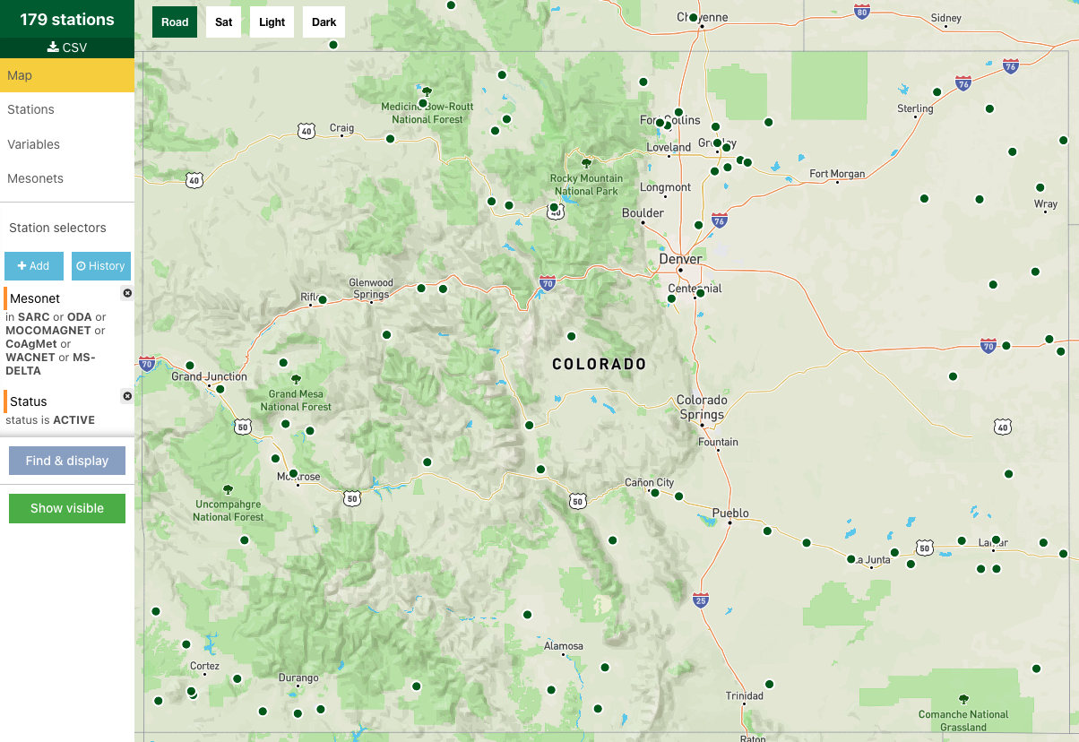
Data Providers - Who are they?
Agricultural Networks
Monitoring weather conditions most impactful to agriculture (e.g. evapotranspiration
Data used internally and often shared publicly
Stations typically located in more rural and farming communities
© 2022 - Synoptic Data - A Public Benefit Corporation
Notes:
Information from
https://coagmet.colostate.edu/

Slide 18
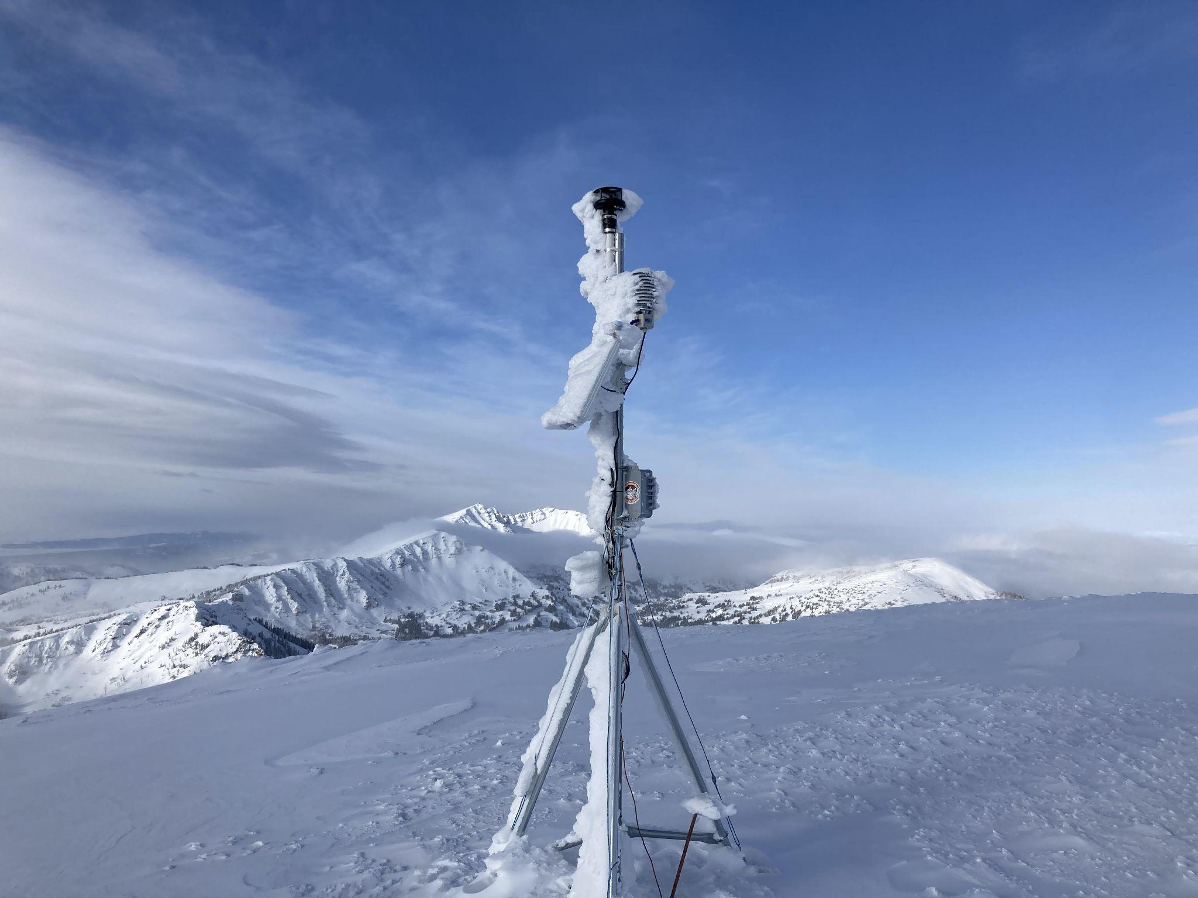
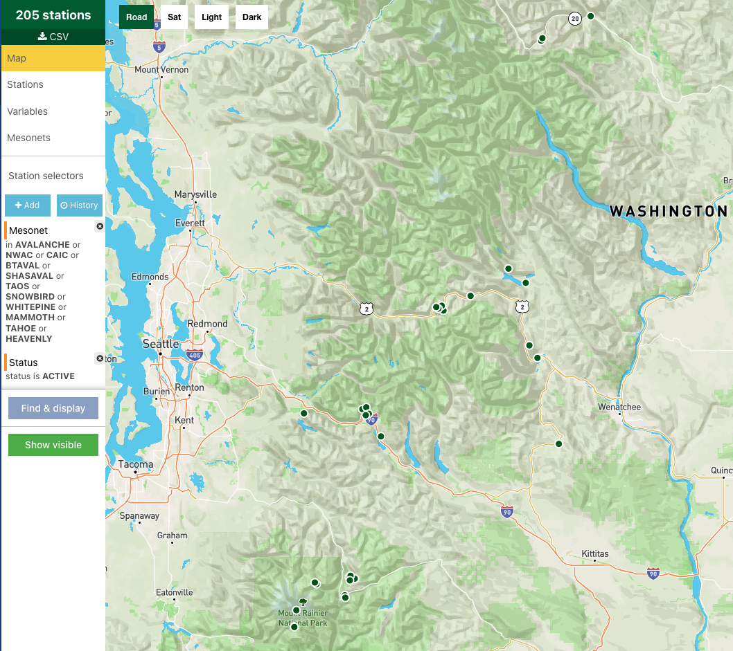
Data Providers - Who are they?
Ski and Avalanche Networks
Monitoring weather conditions impacting on-mountain safety and avalanche conditions
Data used internally and often shared publicly
Stations located in and around ski resorts and avalanche-prone terrain
© 2022 - Synoptic Data - A Public Benefit Corporation
Notes:
Image from
https://www.mtavalanche.com/index.php/images/22/rimed-weather-station-sawtelle-peak

Slide 19
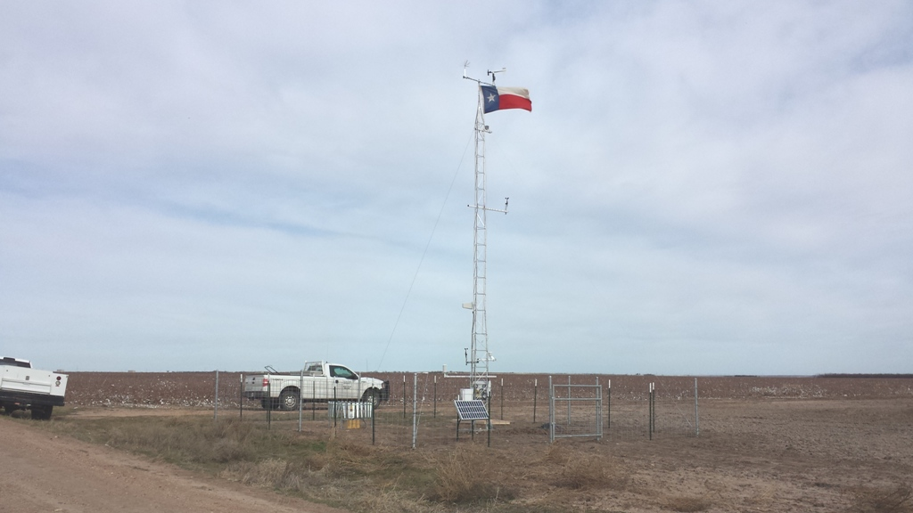
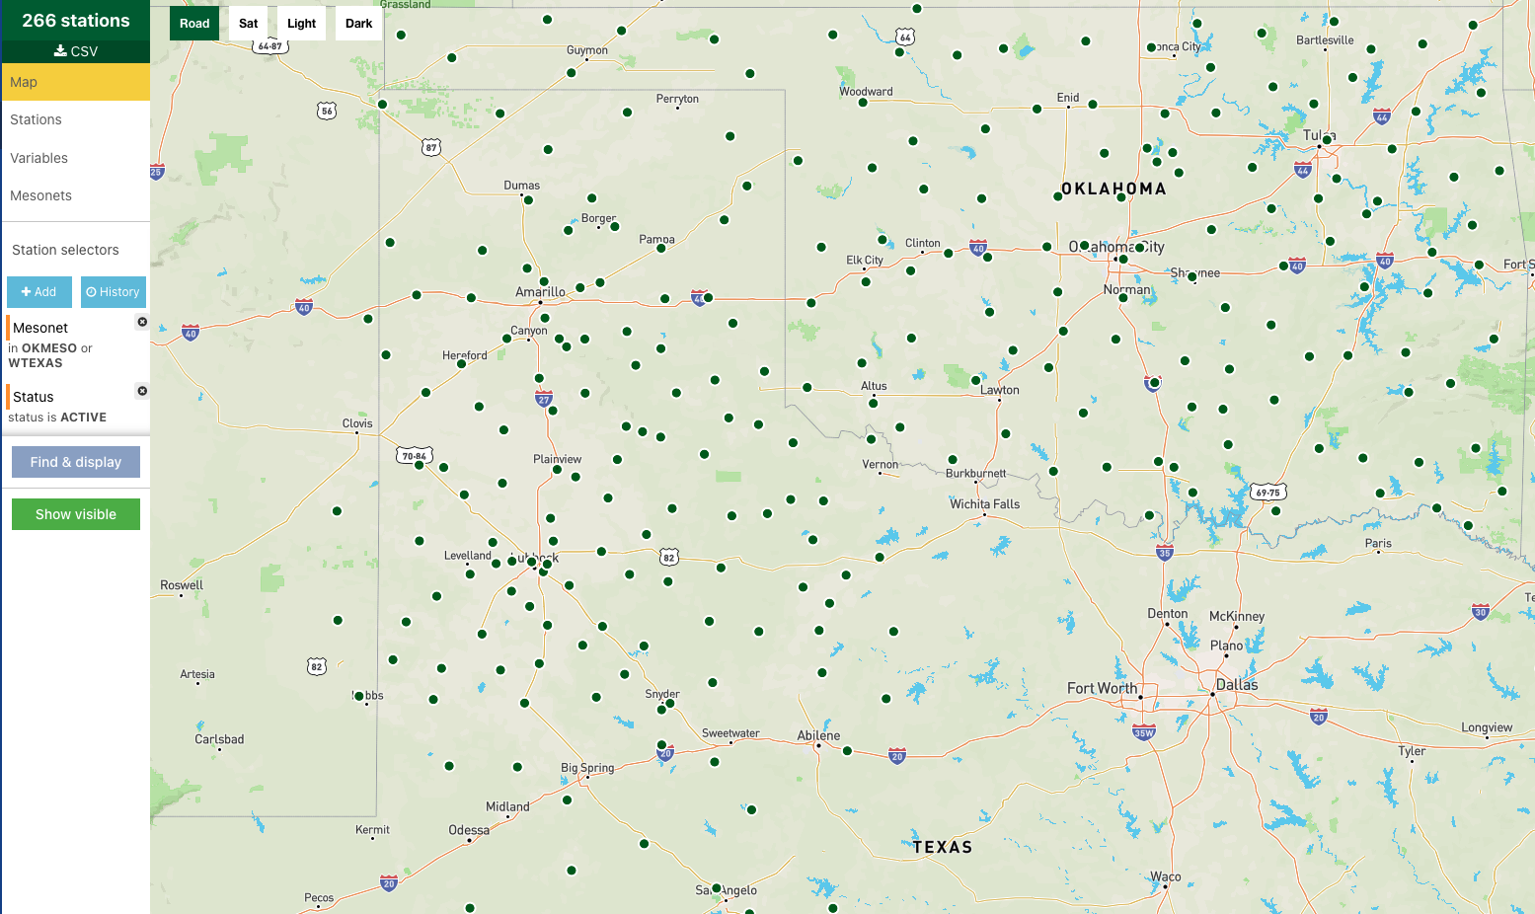
Data Providers - Who are they?
University Mesonets
Monitoring various weather conditions for situational awareness and research
Some data shared publicly, other data is restricted and requires purchase to access
Stations across states where universities have set up (Texas, Oklahoma, Kansas, Illinois, Indiana, New York, and growing!)
© 2022 - Synoptic Data - A Public Benefit Corporation
Notes:
Image from https://www.mesonet.ttu.edu/

Slide 20
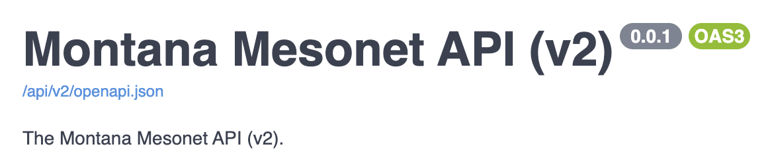
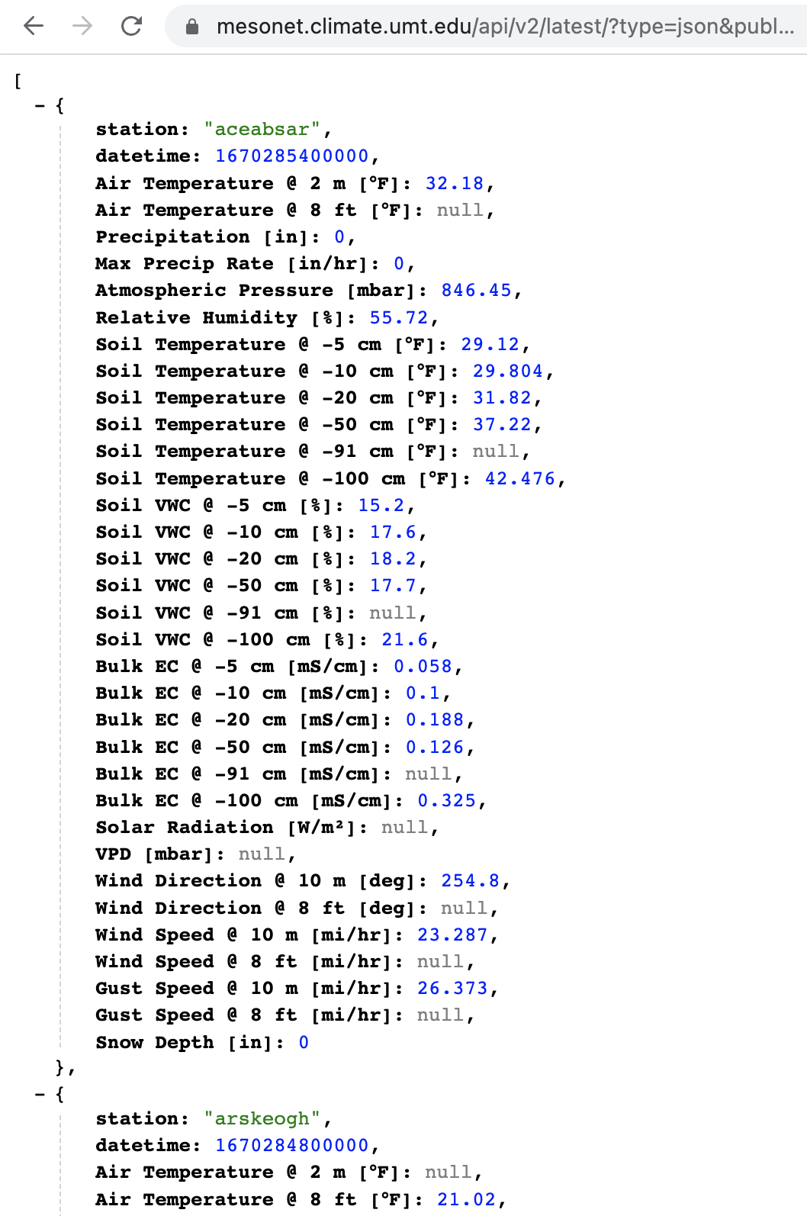
Data providers - Ways to get data directly from provider
Many network providers have their own method for sharing data (API, data download, SFTP, etc)
© 2022 - Synoptic Data - A Public Benefit Corporation

Slide 21
Measurement to Dissemination - Getting to Synoptic
CWOP server
Synoptic server
One way to share data publicly is to provide the data to Synoptic Data
This typically comes from a server that has already aggregated multiple stations (not transmitted directly from station)
Synoptic needs 1) metadata information (units, location, network, etc) and 2) data feed (pull, push, etc)
© 2022 - Synoptic Data - A Public Benefit Corporation

Slide 22
Measurement to Dissemination - Synoptic ingest & processing
Station observations
Observations database
Metadata database
Datetime (Mountain Time Zone) | Temperature (°F) | Relative Humidity (%) | Pressure (mb) | Wind Speed (mph) | Wind Direction (°)
1/8/2023 8:00AM LST | 50 | 40 | 905.7 | 2.0 | 167
1/8/2023 8:15AM LST | 50 | 40 | 905.7 | 3.0 | 163
1/8/2023 8:30AM LST | 51 | 38 | 905.6 | 3.0 | 168
1/8/2023 8:45AM LST | 52 | 37 | 905.6 | 2.0 | 170
Datetime | STID | network_id | var1 | var2 | var3 | var4 | var5
STID | network_id | lat | lon | elevation | height_var1 | height_var2 | height_var3
Once station metadata is added into the metadata database, observations can flow into Synoptic to be processed (QC checks, storage) and disseminated when needed
© 2022 - Synoptic Data - A Public Benefit Corporation

Slide 23



Measurement to Dissemination - Synoptic dissemination
Observations database
Datetime | STID | network_id | var1 | var2 | var3 | var4 | var5
Synoptic Data Mesonet API
GET https://api.synopticdata.com/v2/stations/latest?&token={token}&stid=KDEN
Data stream to NOAA
Synoptic Data shares all observations regularly with NOAA through the National Mesonet Program
Observations can also be obtained by calling the Synoptic Data Mesonet API
© 2022 - Synoptic Data - A Public Benefit Corporation

Slide 24
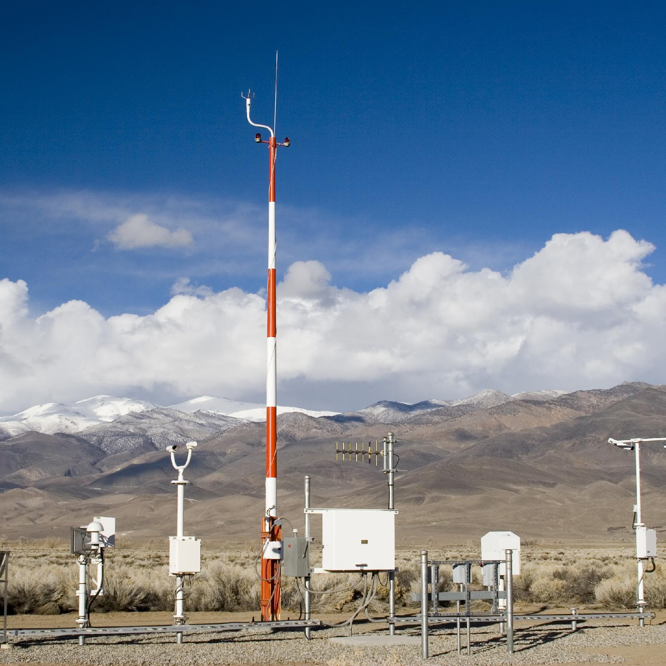
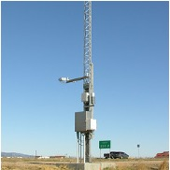
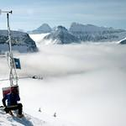

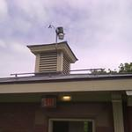
Measurement to Dissemination - Synoptic dissemination scaled
Synoptic Data Mesonet API
NOAA and National Weather Service
Enterprise, university customers, etc
Through robust and scalable back-end processes, Synoptic Data can ingest, process, and disseminate obs from over 100,000 stations
© 2022 - Synoptic Data - A Public Benefit Corporation

Slide 25
There are other ways to get public data!
Iowa State - https://mesonet.agron.iastate.edu/archive/
MesoWest - https://mesowest.utah.edu/
NOAA’s MADIS - https://madis.ncep.noaa.gov/
NOAA NCEI - https://www.ncei.noaa.gov/access/homr/
Desert Research Institute (RAWS) - https://raws.dri.edu/
The data available from Synoptic is:
real time
available at low latency
provisional
available alongside data from 100s of other networks
© 2022 - Synoptic Data - A Public Benefit Corporation

Slide 26
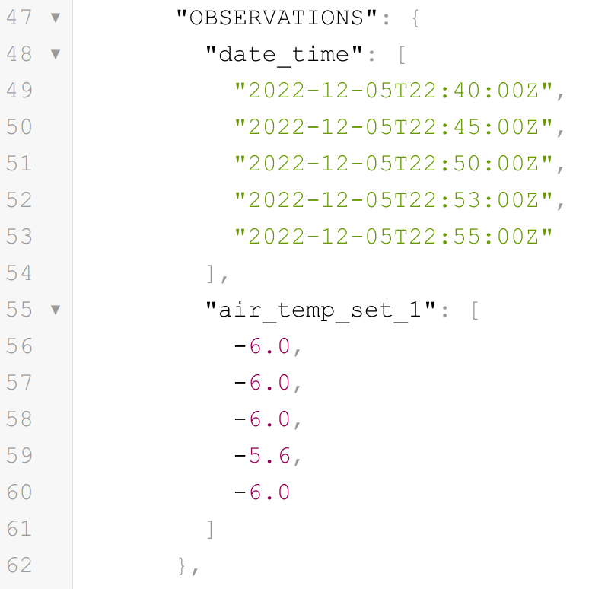
Synoptic’s API
REST API
Client - server, managed through HTTP
Stateless (no client state preserved, all necessary info is contained in the request)
We are always waiting. Send a request, receive the data in a predictable format (JSON)
1. Make a request to HTTP endpoint
https://api.synopticdata.com/v2/stations/timeseries?stid=KMSO&vars=air_temp&recent=30
2. Specify your request through arguments
3. Get your data!

Slide 27
Synoptic’s API Endpoints
https://api.synopticdata.com/v2/stations
/timeseries
/nearest
/latest
/metadata
/precip
https://developers.synopticdata.com/mesonet/

Slide 28
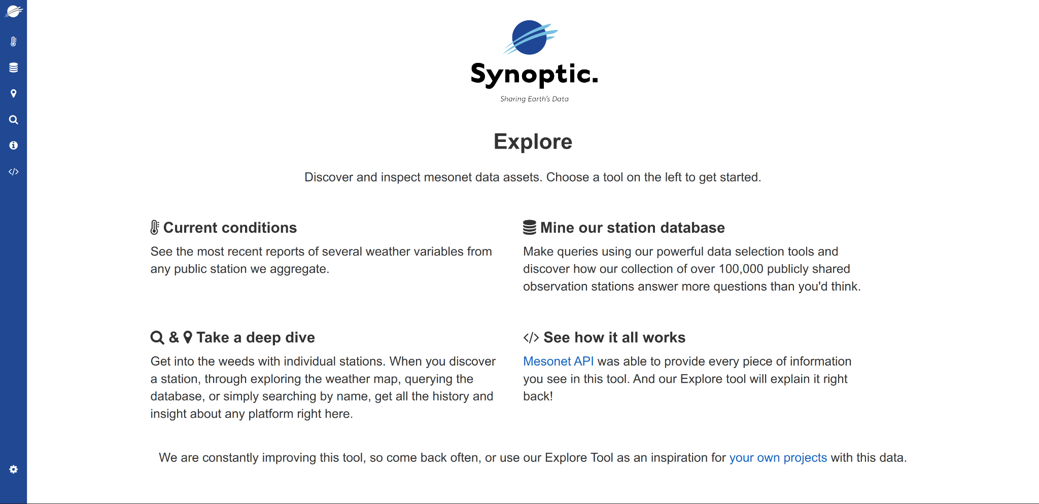
Getting Started: The Synoptic Explore Tool
https://explore.synopticdata.com/
Goals:
Familiarize with the data Synoptic aggregates
Understand the API requests giving the data on your screen
Familiarize with the returned JSON structure
Notes:
Break out and have participants go to explore

Slide 29
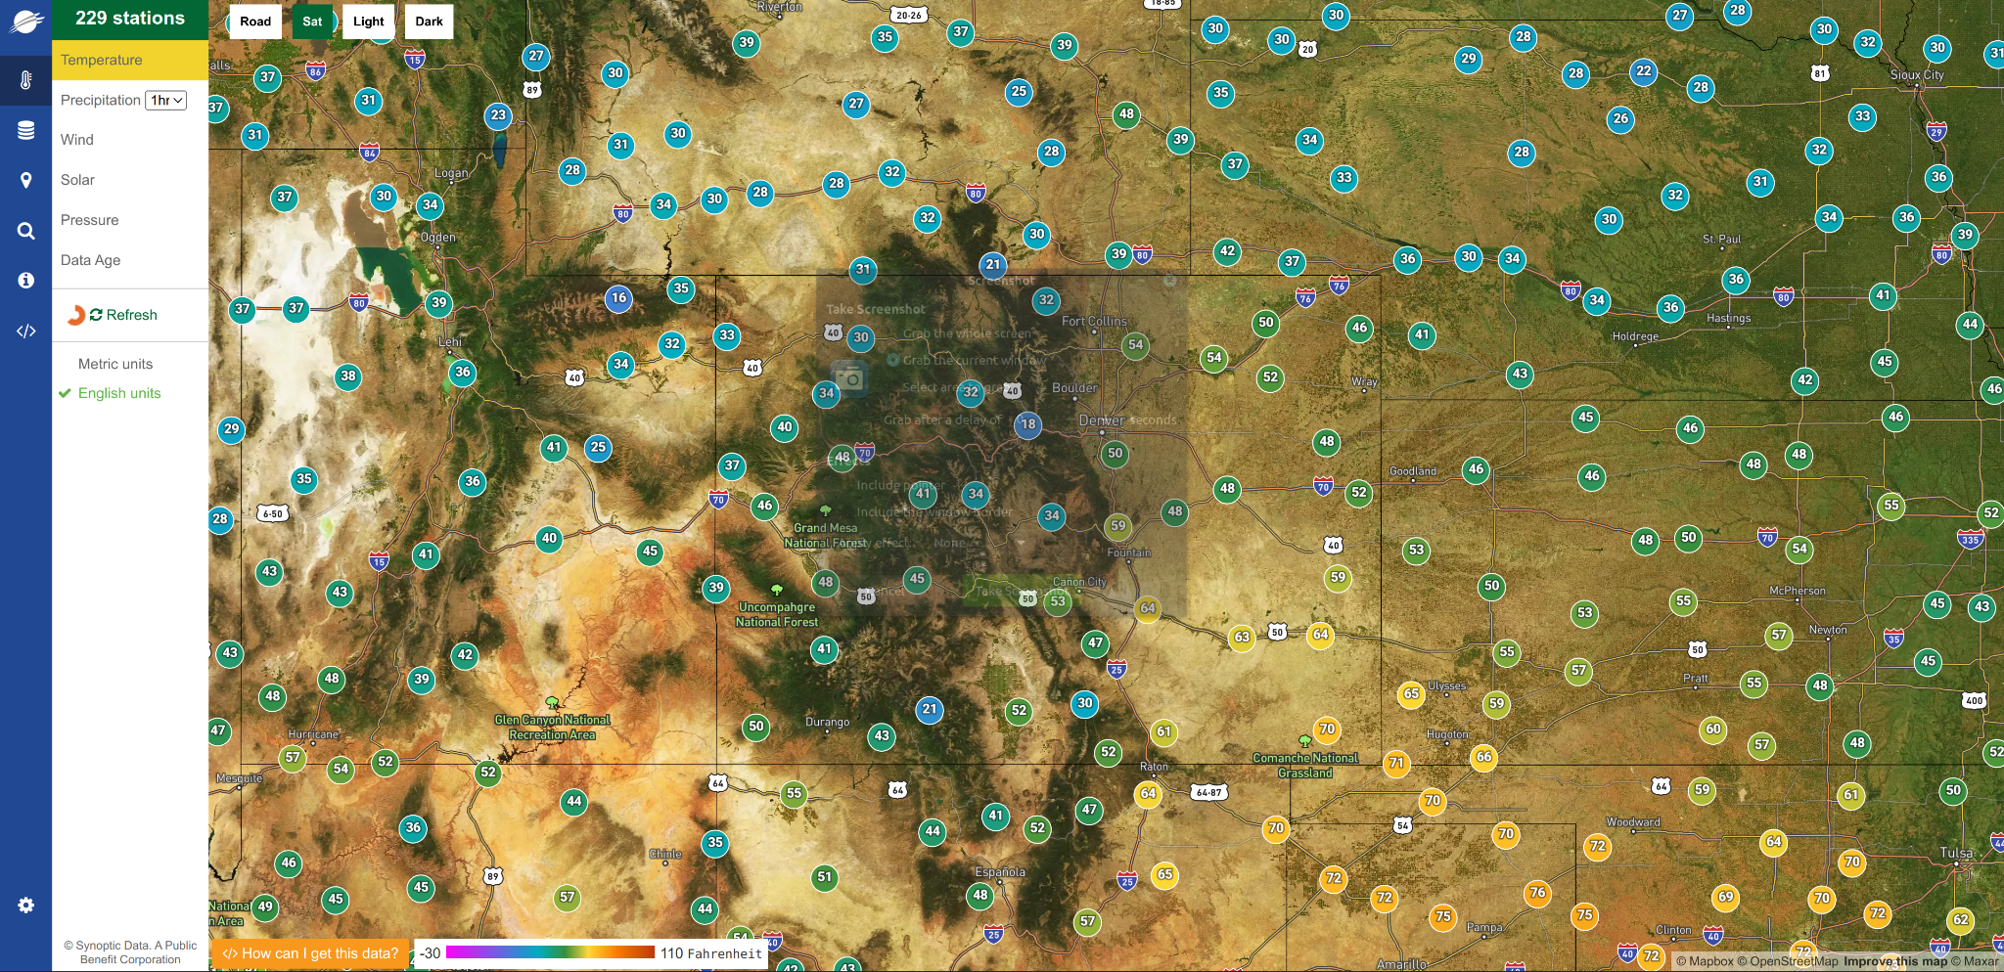
Exercise 0: Current Conditions
Identify the network a station obs belongs to
Zoom in/out. Additional stations appear (spacing restriction in API request for aesthetics
Select ‘Solar’ variable – how many fewer stations appear than ‘Temperature’ variable? – Not all stations report the same variables!
Closest station to your geographic area of interest? House?
Precipitation – this utilizes our precip processing (will get into more detail if time allows)

Slide 30
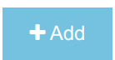
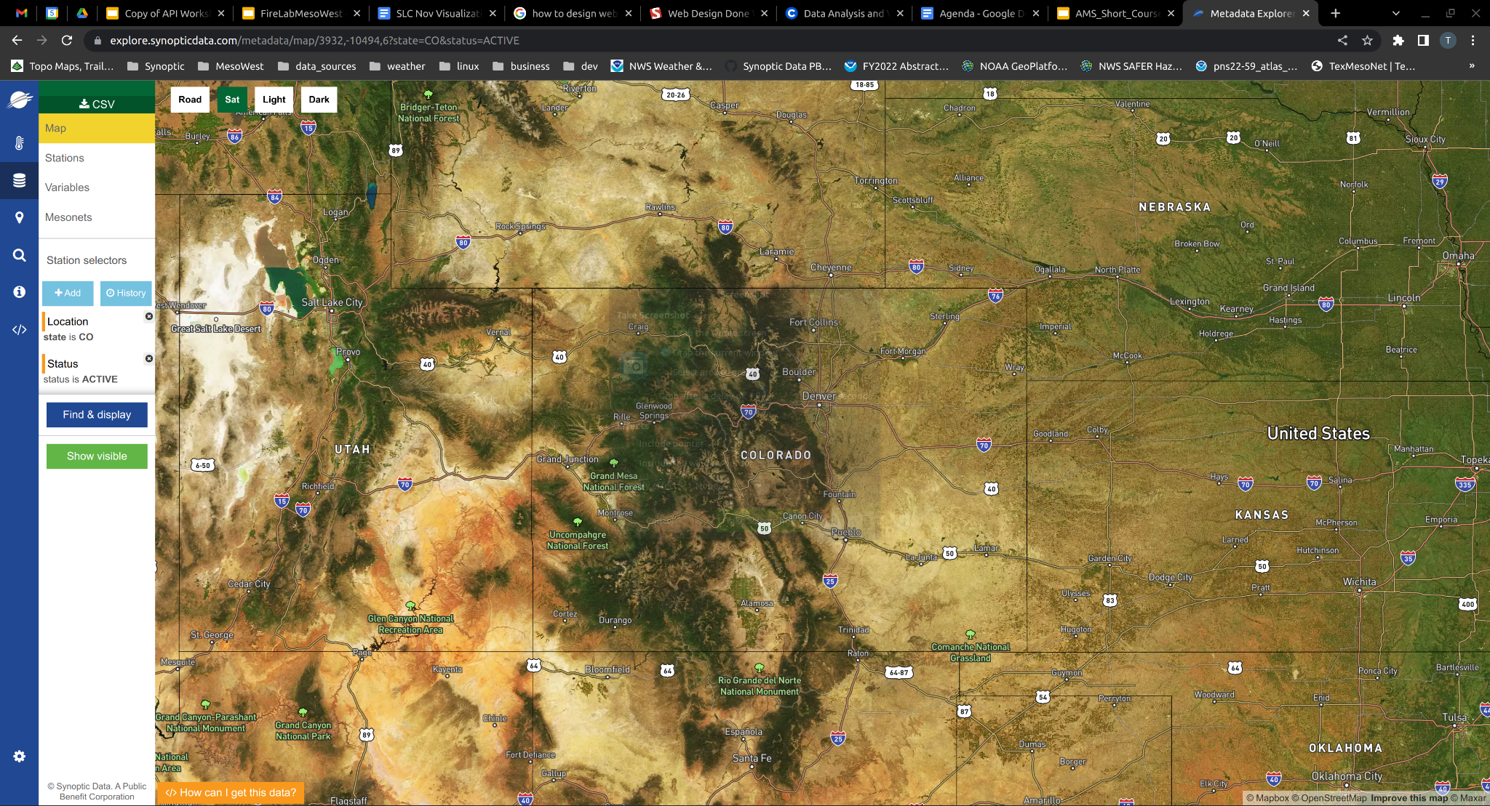
Exercise 1: Metadata Explorer
is your friend
How many stations in your state?
How many mesonets? Even distribution or are majority of stations in a single mesonet? COCORAHS is an outlier!
How many stations report air temp?
How many stations within a 10 mile radius of the AMS conference site? (39.7435,-104.9949,10)
Update the filter to limit to the 10 nearest stations. Closest CDOT? CO006

Slide 31
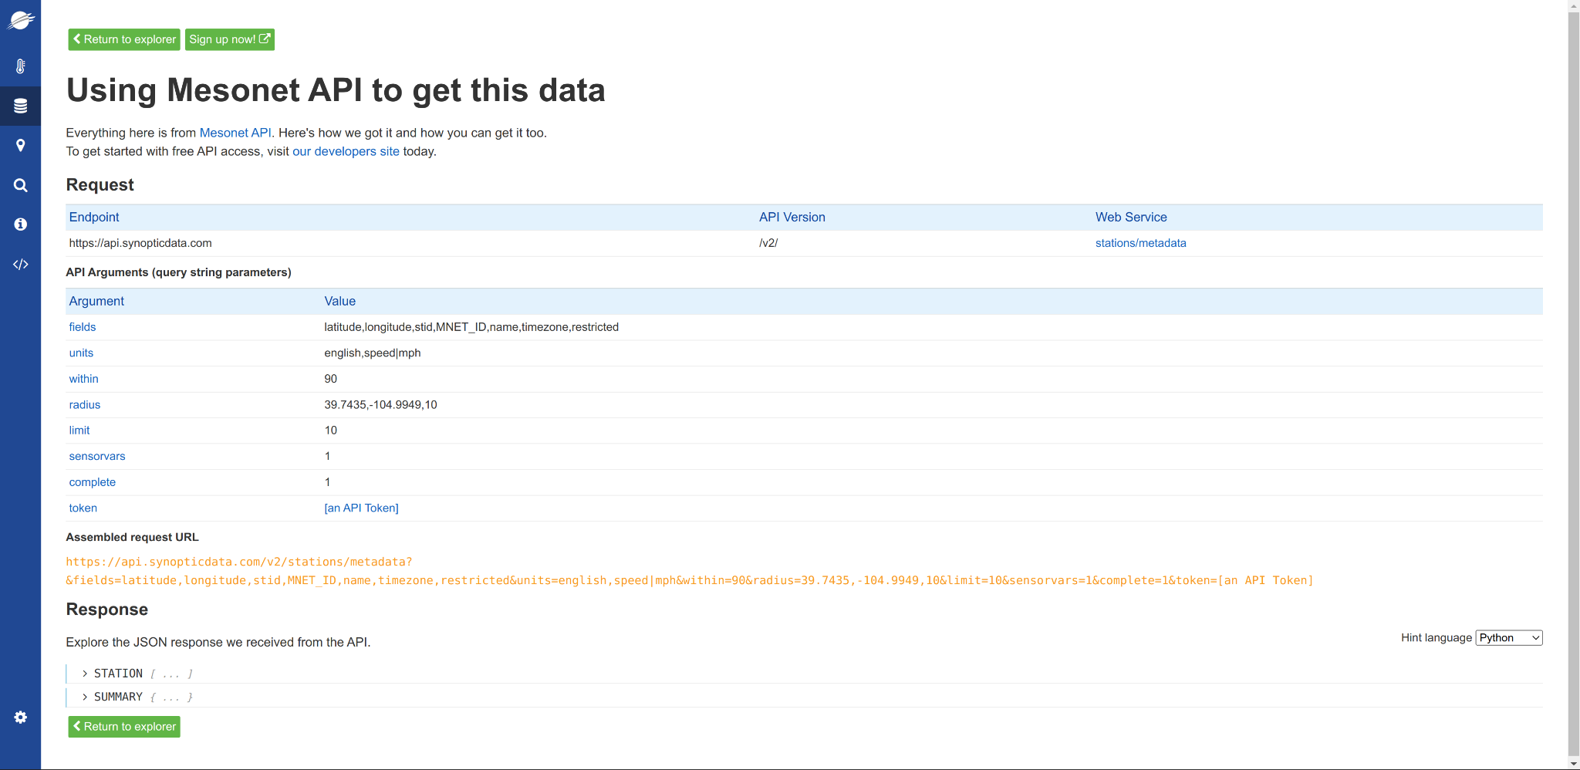
Exercise 2: Understanding the API Request
Run through the API arguments. Some of these are relict from current conditions – that’s ok.
Web service – we’re targeting the ‘metadata’ endpoint with our metadata discovery exercise
Radius, limit, sensorvars, complete – API arguments for the metadata service
Open ‘Mesonet API’ in a different tab. Can view all the different available arguments for the different services. We won’t get into this now but this documentation is your friend
Take a look at the request URL. Format. Argument=Value, separated with &
Notice the url. We can actively change the url and it will update the Response.

Slide 32
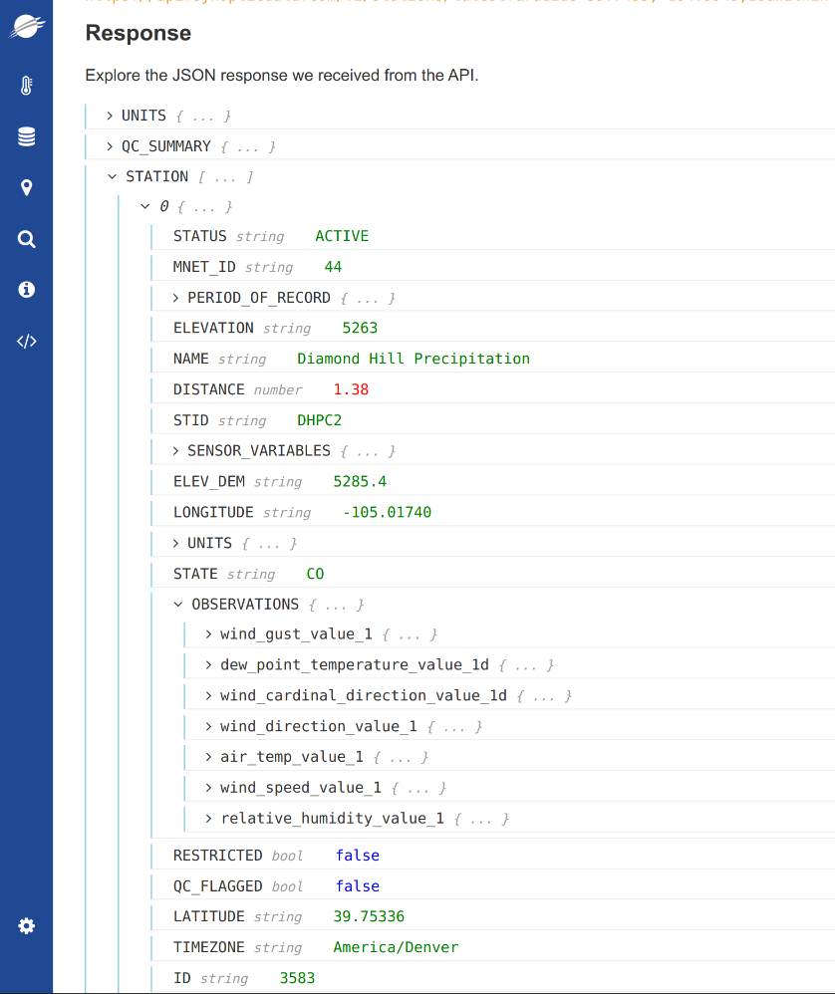
Exercise 3: Understanding the JSON return structure
Structure of the metadata request. STATION, SUMMARY and values will be key value pairs in the JSON dictionary.
Change the endpoint in the url from ‘metadata?’ to ‘latest?’. Eliminate ‘limit=10’ and replace it ‘within=90’. Now showing data from all stations in radius that have reported within the last 90 minutes
SUMMARY – returned many tens stations in not much time
UNITS – all vars returned & default units
QC_SUMMARY – by default Range check is applied
STATION – list of stations with data
OBSERVATIONS – the data
We can make similar requests to other endpoints

Slide 33



Python:
From request to using the data
Data Request
urllib.request
standard library, (requests easy parameter integration, but pip-installed)
Initial parsing
json
Workable data structure
pandas
** This is not exclusive **

Slide 34
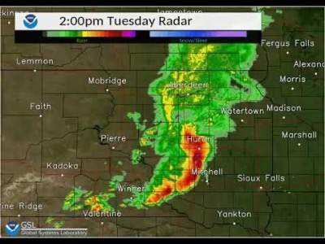
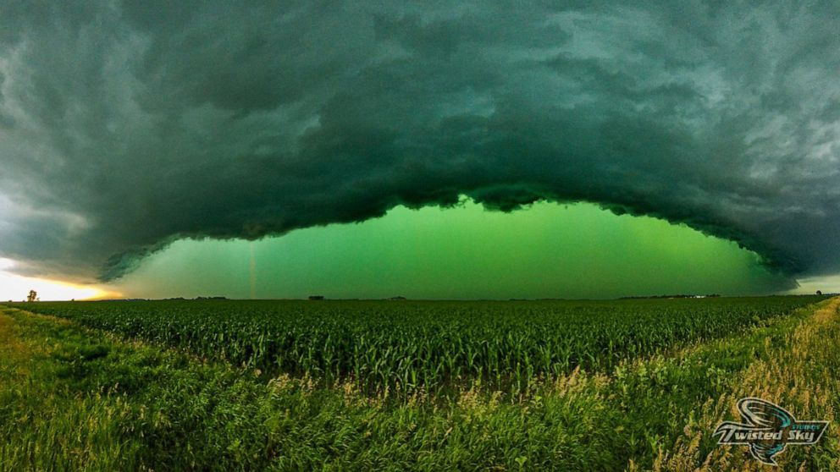
Northern Plains Derecho – July 5, 2022
© 2022 - Synoptic Data - A Public Benefit Corporation
Notes:
https://youtu.be/TxTfNTYKsiA?t=12
https://abcnews.go.com/US/derecho-turns-skies-green/story?id=86336580

Slide 35
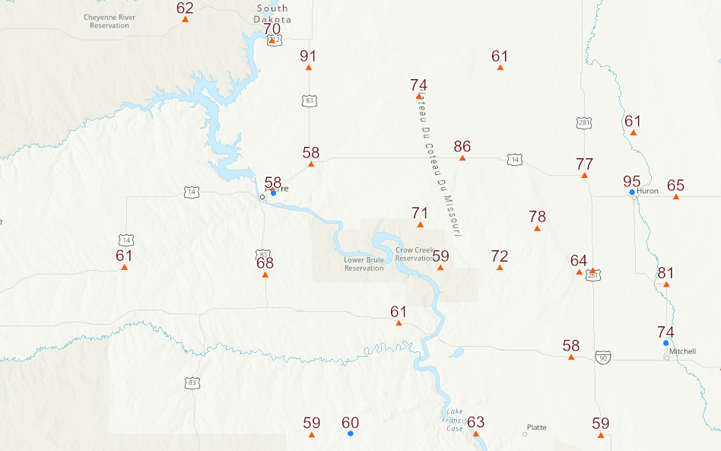
Northern Plains Derecho – July 5, 2022
11am
© 2022 - Synoptic Data - A Public Benefit Corporation
Notes:
https://synoptic.maps.arcgis.com/apps/mapviewer/index.html?webmap=fb10afade04e47eaa2372a69c439433f

Slide 36
Northern Plains Derecho – July 5, 2022
12pm
© 2022 - Synoptic Data - A Public Benefit Corporation
Notes:
https://synoptic.maps.arcgis.com/apps/mapviewer/index.html?webmap=fb10afade04e47eaa2372a69c439433f

Slide 37
Northern Plains Derecho – July 5, 2022
1pm
© 2022 - Synoptic Data - A Public Benefit Corporation
Notes:
https://synoptic.maps.arcgis.com/apps/mapviewer/index.html?webmap=fb10afade04e47eaa2372a69c439433f

Slide 38
Northern Plains Derecho – July 5, 2022
2pm
© 2022 - Synoptic Data - A Public Benefit Corporation
Notes:
https://synoptic.maps.arcgis.com/apps/mapviewer/index.html?webmap=fb10afade04e47eaa2372a69c439433f

Slide 39
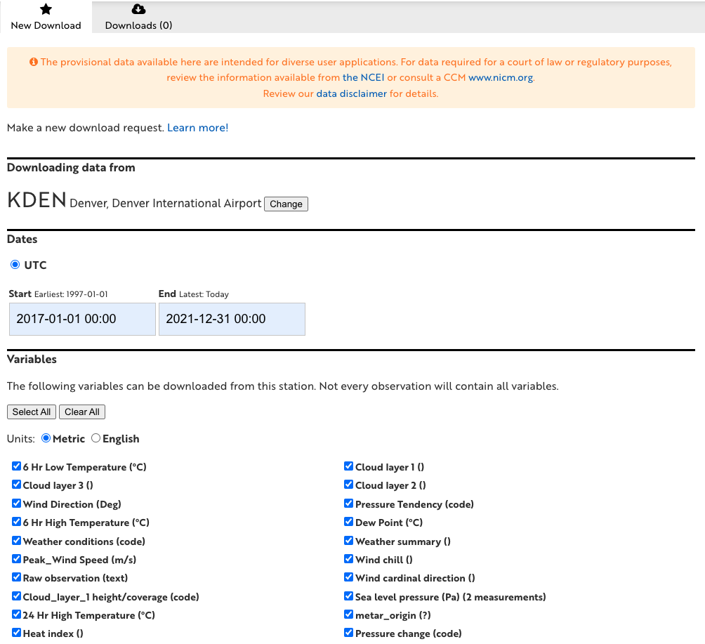
We also have a tool for simple csv download.
Less customizable than API:
Grab single station data for:
Window of time
Specified units
Selected (or all) variables
© 2022 - Synoptic Data - A Public Benefit Corporation

